Slide 1
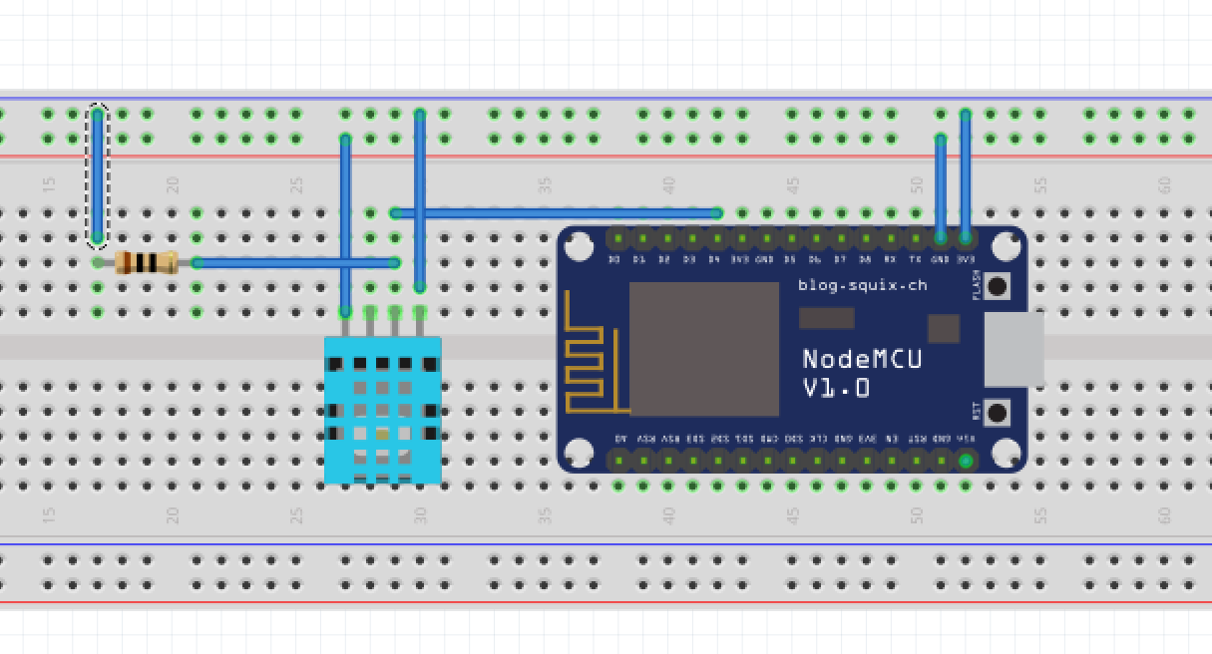
WIRELESS MONITORING SYSTEM FOR GREENHOUSE PARAMETERS
WIRELESS MONITORING SYSTEM FOR GREENHOUSE PARAMETERS
G.ABHIRAM 171EC117
J.AJAY READDY 171EC120
G.ABHIRAM 171EC117
J.AJAY REDDY 171EC120

Slide 2
OBJECTIVES OF PROJECT
Temperature, humidity and soil mositure sensing system for green houses.
Wirelessly data collecting and alerting according to sensors data
Progress:
Circuit for temperature and humidity(using dht11 sensor) and relaying real time data to online cloud database(dweet.io) by using http get requests and android app for showing the data is completed

Slide 3
Targets:
Setting up a local data collecting server for low latencies and for collecting large amount of data for processing.
New Soil moisture sensor
Alerting system though email or app notifications about the parameters.
url for git hub repository
Nodemcu as micro controller,dht11 as temperature and humidity sensor, Arduino ide for programing, dweet.io a cloud database, android studio for app.

Slide 4
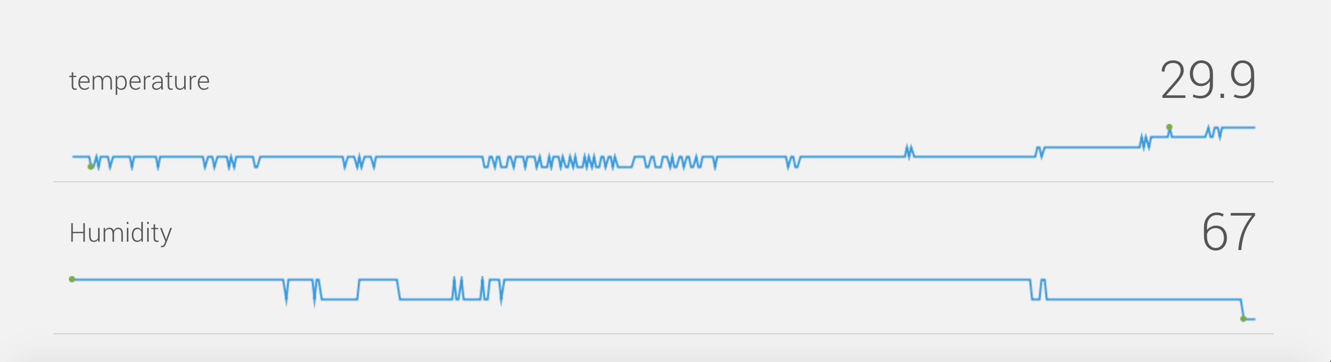
RESULTS:

